Slide 1
Arrays
Chapter 8

Slide 2

8.1
One-dimensional Arrays

Slide 3
Creating an Array
An array is created using the var keyword, followed by the array name.
An array is declared using the JavaScript keywords new Array().
The number of elements in the array may be specified inside the parentheses but not required.
Example: an array named players[] that contains places for 200 players in a game is:
var players = new Array(200);
The name of the array is similar to the name of a variable.
To identify a particular element in an array, an index number is placed within brackets ([]).
The first element of an array has index number 0.
An array with 200 elements will have index numbers from 0 to 199.

Slide 4
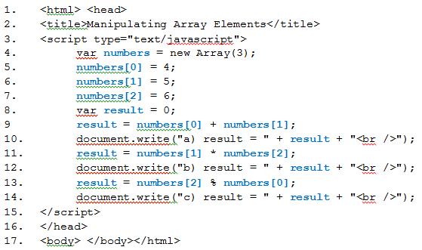
Manipulating Array Elements
a) result = 9 b) result = 30 c) result = 2

Slide 5
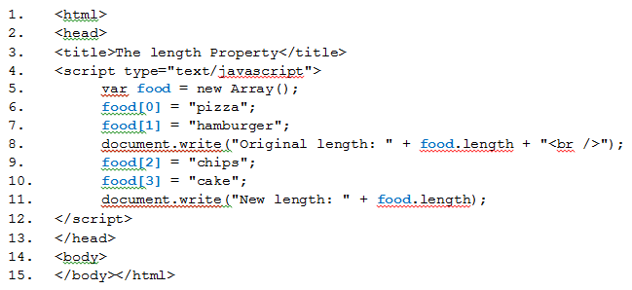
The length Property
Original length: 2 New length: 4

Slide 6
Methods of the Array Object
Method | Description
concat() | joins two or more arrays, and returns a copy of the joined arrays
join() | joins all elements of an array into a string
push() | adds new elements to the end of an array, and returns the new length
reverse() | reverses the order of the elements in an array
shift() | removes the first element of an array, and returns that element
sort() | sorts the elements of an array
splice() | adds/removes elements from an array
toString() | converts an array to a string, and returns the result
unshift() | adds new elements to the beginning of an array, and returns the new length

Slide 7
8.2
Populating Arrays

Slide 8
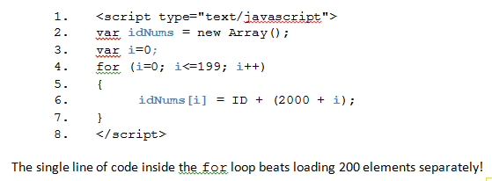
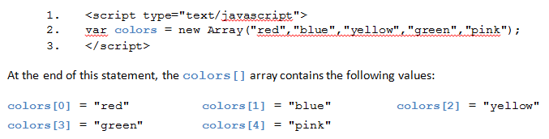
Loading Arrays Directly

Slide 9
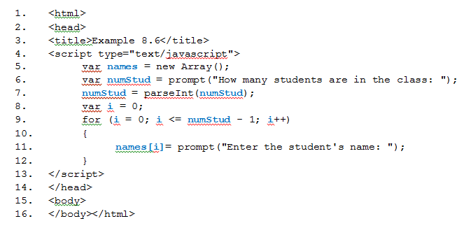
Loading Arrays Interactively

Slide 10
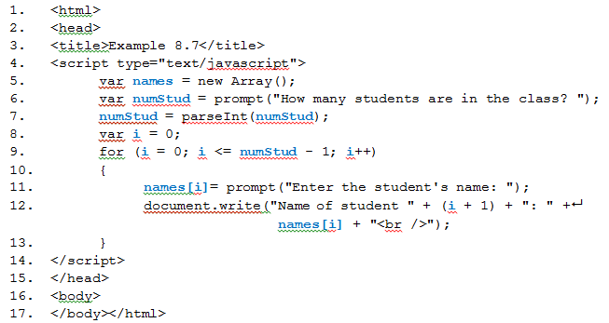
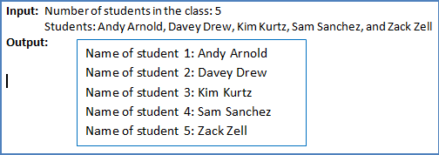
Displaying Arrays

Slide 11
8.3
Parallel Arrays

Slide 12
Parallel Arrays
Parallel arrays are arrays of the same size in which elements with the same subscript are related.
Example: keep records of information for students:
names[]
homeworkGrades[]
testGrades[]
courseAverage[]
For each k, names[k], homeworkGrades[k], testGrades[k],and courseAverage[k] would refer to the same student so they are related data items.

Slide 13
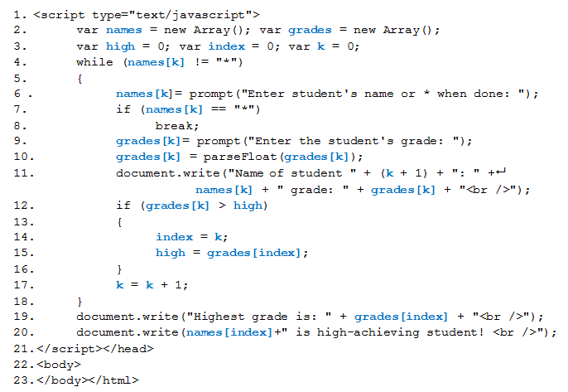

Slide 14
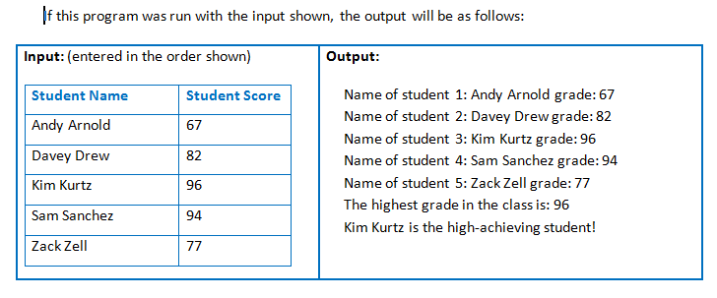

Slide 15
Why Use Arrays?
Arrays can reduce the number of variable names needed in a program.
We can use a single array instead of a collection of simple variables to store related data.
Arrays can help you create more efficient programs.
Once data is entered into an array, it can be processed many times without having to be input again.

Slide 16
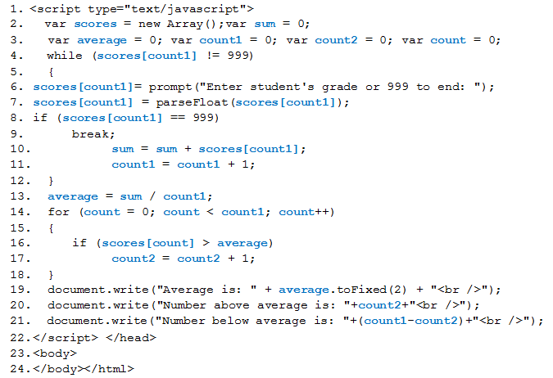

Slide 17
8.4
Using Array Methods

Slide 18
The push() Method
The push() method makes it easy to add an item (or several items) to an array.
Given: an array named myArray[] which has been filled with some, the syntax to add another name is as follows:
myArray.push("newName");
The syntax to add several names is as follows:
myArray.push("newName1","newName2","newName3",...);

Slide 19
The unshift() Method
The unshift() method inserts the array element values at the beginning of the array instead of at the end.
Given: an array named myArray[] which has been filled with some names, the syntax to add another name at the beginning is as follows:
myArray.unshift("newName");
The syntax to add several names is as follows:
myArray.unshift("newName1","newName2","newName3",...);

Slide 20
The splice() Method
The splice() method allows you to insert or delete one or more array element values
Requires several parameters:
define at what position to add or remove an item or items (the index parameter)
if removing items, must stipulate the number of items to be removed
if adding items, this parameter is set to 0
include the items to be added, if there are any
general syntax:
arrayName.splice(index,howmany,newItem1,.....,newItemX);
syntax to delete the first three items in an array:
arrayName.splice(0,3);
the 0 means to start at the first element
the 3 means to delete the three items, beginning at the item with index = 0
syntax to add two items in the middle, starting at the fifth element:
arrayName.splice(4,0,newItem1,newItem2);
the 4 means to start at the fifth element (the index value of this element is 4)
the 0 means that no items will be deleted
newItem1 and newItem2 will be added, in the fifth and sixth places of the array
all remaining elements in the array will be pushed to the end

Slide 21
8.5
Multi-Dimensional Arrays

Slide 22
Introduction to Two-Dimensional Arrays
a two-dimensional array is a collection of elements of the same type stored in consecutive memory locations
all are referenced by the same variable name using two subscripts
JavaScript arrays are objects; therefore, a two-dimensional array is actually an array of arrays
each subscript has its own set of brackets
this does not affect how we use the two-dimensional array.
Once the values have been assigned, to access any element of the array use the notation: myArray[subscript 1][subscript 2]

Slide 23
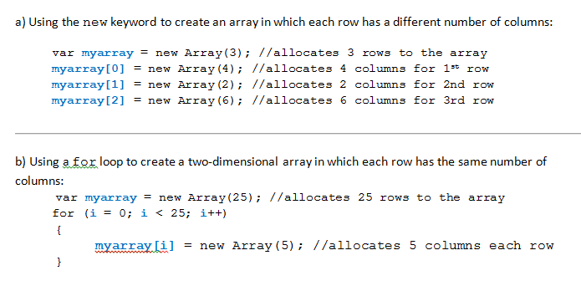
Creating a Two-Dimensional Array

Slide 24
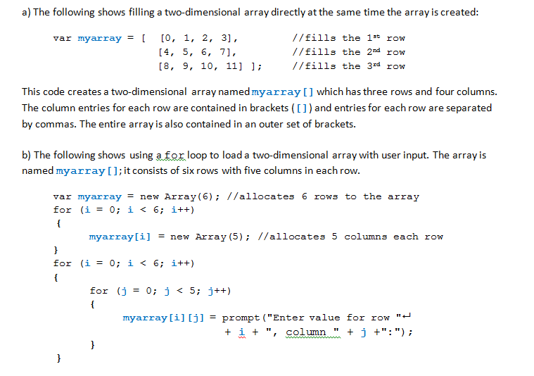
Filling a Two-Dimensional Array

